Slide 2
Responsibilities and FUNDING
Helen Cuervo, P.E. | District Engineer, Northern Virginia
April 23, 2018

Slide 3
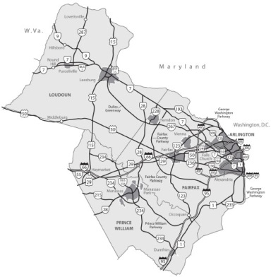
Northern Virginia District
Fairfax, Loudoun, Prince William, Arlington Support cities and towns
2.4 million residents
760 employees
Maintain almost 14,000 lane miles
More than 500 miles of regional bike facilities
Notes:
Our network is heavily secondary roads – 11,000+ lane miles

Slide 4
Northern Virginia District
1,400+ traffic signals
2,200 bridges and large culverts (10% of state)
250,000 signs
24 park-and-ride lots with 12,000 spaces
13,000 ancillary structures
More than 100 miles of soundwalls
Notes:
- 10% of the state’s bridges and large culverts
- 40% of the state’s ancillary structures- sign, signal, high-mast light/camera poles

Slide 5
VDOT’s Responsibilities:
Plan
Design and Construct
Operate and Maintain
The Commonwealth’s transportation facilities.

Slide 6
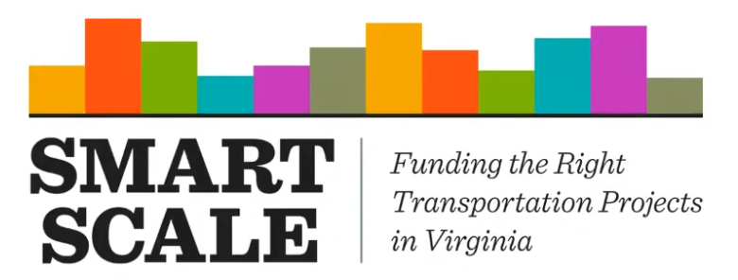
Planning
Regional planning:
Including MWCOG Transportation Planning Board (TPB), Climate, Energy and Environment Policy Committee (CEEPC), and Air Quality Committee (MWAQC)
NVTA board member (non-voting)
Other (NVRC, NVTC, VRE, transit agencies, localities, etc.)
Collaborate with Office of Intermodal Planning and Investment in development of VTRANS and prioritization (SMART SCALE)
Support development/implementation of Six-Year Improvement Plan
Land use (review, permits, acceptance)
Notes:
In 2017 in NOVA: - More than 5,000 permits issued across the district
More than 2,300 plan reviews for land development
Accepted more than 100 new lane miles into our system (in some past years more than 200 a year)

Slide 7
Design and Construction
Administer or review/accept all design/work on state roads (developer, localities, utilities, etc.)
Traditional design-bid-build, design-build, Megaprojects
As of April, administering 36 projects under construction worth $548 million in NOVA
$4+ billion Megaprojects program including:
66 Express Lanes Beltway to Gainesville
395 Express Lanes
Environmental, preliminary design for 495 Express northern extension

Slide 8
Maintenance and Operations
Paving, patching, guardrail, drainage, bridge and other repairs
Respond to emergencies: infrastructure damage, homeland security, flooding
Snow removal
Work 24/7 with police and fire to clear incidents, reopen lanes as quickly as possible
Manage Tolling/66 Express Inside the Beltway
HOV, shoulder lanes, message signs, 511 and traffic information

Slide 9
VDOT’s Annual Budget
FY2018: $5.4 billion
$356 million | Debt service
$2.13 billion | Road maintenance and operations
$548.6 million | Support to other agencies, tolls, administration and other programs
$492.5 million | Passed through to NVTA/HRTAC
$1.87 billion | Construction
Notes:
These numbers are per year.

Slide 10
More on Construction Program Funding (SYIP)
Secretary of Transportation, Commissioner and CTB prioritize and allocate through VTRANS, SMART SCALE via Six-Year Improvement Program:
SMART SCALE - District assists localities/sponsors with applications and administers evaluation
State of Good Repair (bridges and pavement)
Special programs (revenue-sharing, federal, etc.)
Other

Slide 11
Other Transportation Funding Programs
Projects and multimodal efforts are often funded in northern Virginia through a combination of state funds, formula federal funds along with:
NVTA
Localities
Public-Private Partnerships (P3)
Toll Revenue Programs (66 Inside the Beltway, 395 Express Lanes, etc.)
Federal grants (TIGER, FLAP, TAP, etc.)
Other (Tax Districts, Proffers, etc.)
Notes:
Tolling/P3 efforts:
I-66 Express Lanes Outside the Beltway: Agreement includes $579 million concession payment--$500 million to fund 14 additional corridor improvements approved by CTB in Jan. 2018
I-66 Inside toll revenues to fund multimodal corridor improvements; partnership with NVTC
I-395 Express - $500 million

Slide 12
Loudoun County Parkway Widening and Old Ox Road Reconstruction (Route 606) Evergreen Mills Road to Dulles Greenway
State & Federal
NVTA
MWAA
Loudoun County
Total Estimate $120 million

Slide 13
Route 1 Corridor, Prince William County Widening to six lanes, right of way for future Rt. 123 interchange; undergrounding utilities
State & Federal
NVTA
Legislative Bonds
Prince William County
Total Estimate $320 million
Notes:
This number includes partnership efforts along the corridor: ours and the county’s widening projects, undergrounding utilities andright of way for the future Route 1/123 interchange

Slide 14
Route 28 Corridor Improvements Ten new interchanges, widening to eight lanes, parallel road improvements (2000s to present)
State
NVTA
Loudoun County
Fairfax County
Tax District
Proffer
Total Estimate $670 million

