Slide 1
Regional Approach to Funding Northern Virginia’s Bicycle and Pedestrian Infrastructure
Technical Advisory Committee (TAC)
October 15, 2025

Slide 2
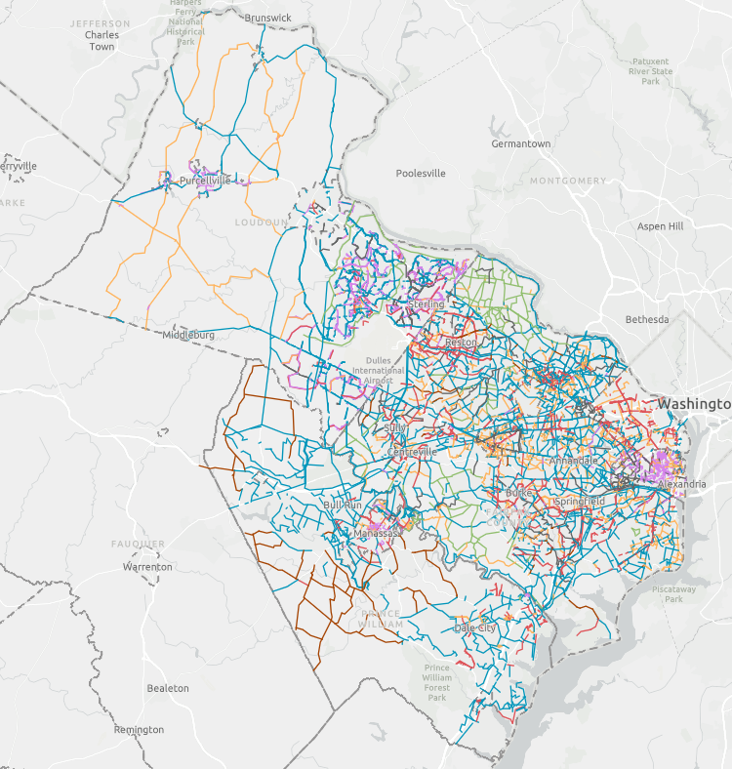
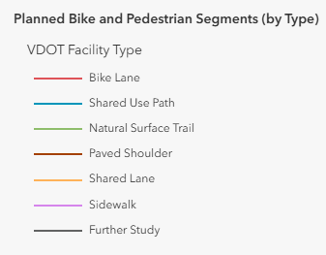
Overview
Goal: Develop recommendations of strategies and sources to fund Northern Virginia’s planned bicycle and pedestrian network as identified in 2024 VDOT study
Methods:
Reviewed and researched funding sources and strategies
Consulted ongoing efforts
Engaged with our regional coordination partners

Slide 3
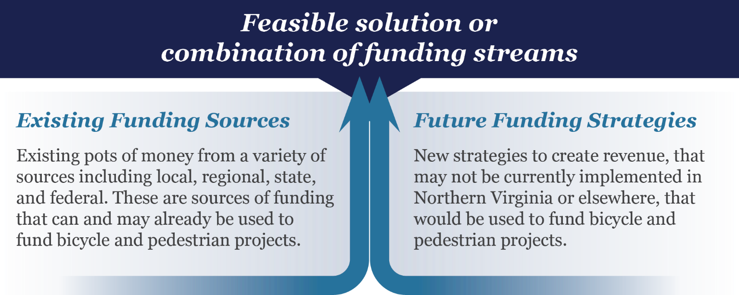
Approach to Funding

Slide 4







Funding Strategy Metric Development
All funding strategies were evaluated against these seven metrics using a qualitative research approach
Available information where strategy was implemented elsewhere
Current local efforts for reference
General knowledge of strategies
Multiple layers of QC on how strategies were assessed for each metric, adjustments were made based on discussions
Impact on Business
Pathway to Implementation
Revenue Growth Potential
Revenue Magnitude
Socioeconomic Burden
Stability
Tax/fee Payer Benefit

Slide 5
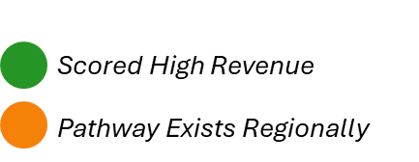
Recommendations
As viable funding strategies are chosen, efforts should focus on revenue estimation, implementation planning, and funding program design to support balanced regional mobility.
Beverage/Alcohol Tax
Business, Professional and Occupational License (BPOL) Tax
E-Commerce Delivery Fee
Income Tax Increase
Land Value Tax
Parking Sales Tax & Fees
Personal Property Tax
Real Estate Tax
Restaurant, Food, or Beverage Tax
Sales Tax Increase
Services Tax
Streaming Services Sales Tax
Transient Occupancy Tax (Lodging or Hotel)
Transportation Utility Fee

Slide 6
Recommendations
The following funding strategies were assessed highly, but are not likely to move forward regionally:
Naming Rights
Business Improvement Districts (BIDs)
Congestion Pricing
Mileage-Based Usage Fee/Vehicle Miles Traveled Fee
Planned Unit Development (PUD) Agreements

Slide 7
Thank you!

