Slide 1
VIRGINIA RAILWAY EXPRESS
Transportation Forum for NOVA’s Elected Leaders
April 23, 2018

Slide 2
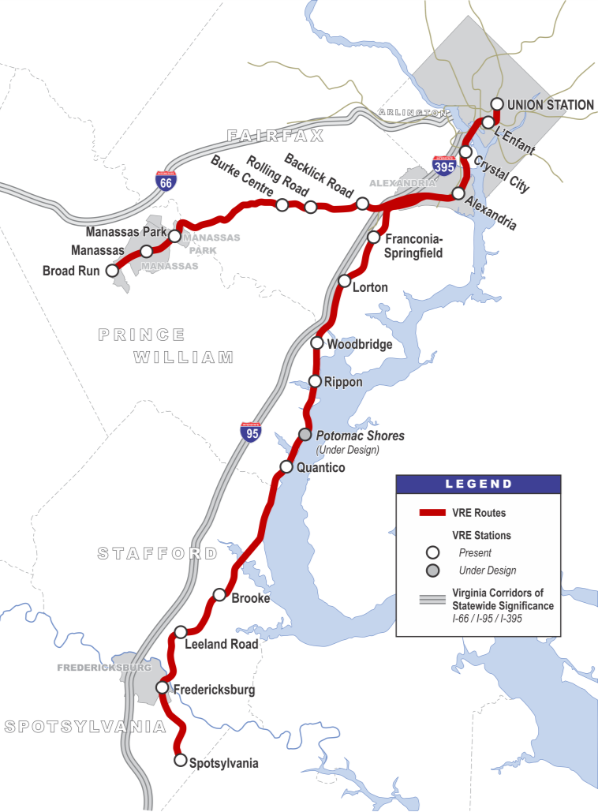
Who we are
A commuter rail system Running on existing railroad tracks since 1992
Serving Washington DC and Northern Virginia Carrying long-distance commuters to DC, Arlington & Alexandria
Nearly 20,000 daily trips Commuters that would otherwise drive alone in cars*
Two lines, 96 miles Adding peak capacity to I-95, I-395 & I-66 corridors*
VIRGINIA RAILWAY EXPRESS
* Source: Texas Transportation Institute, Virginia Railway Express Congestion Relief Contribution; 2015

Slide 3
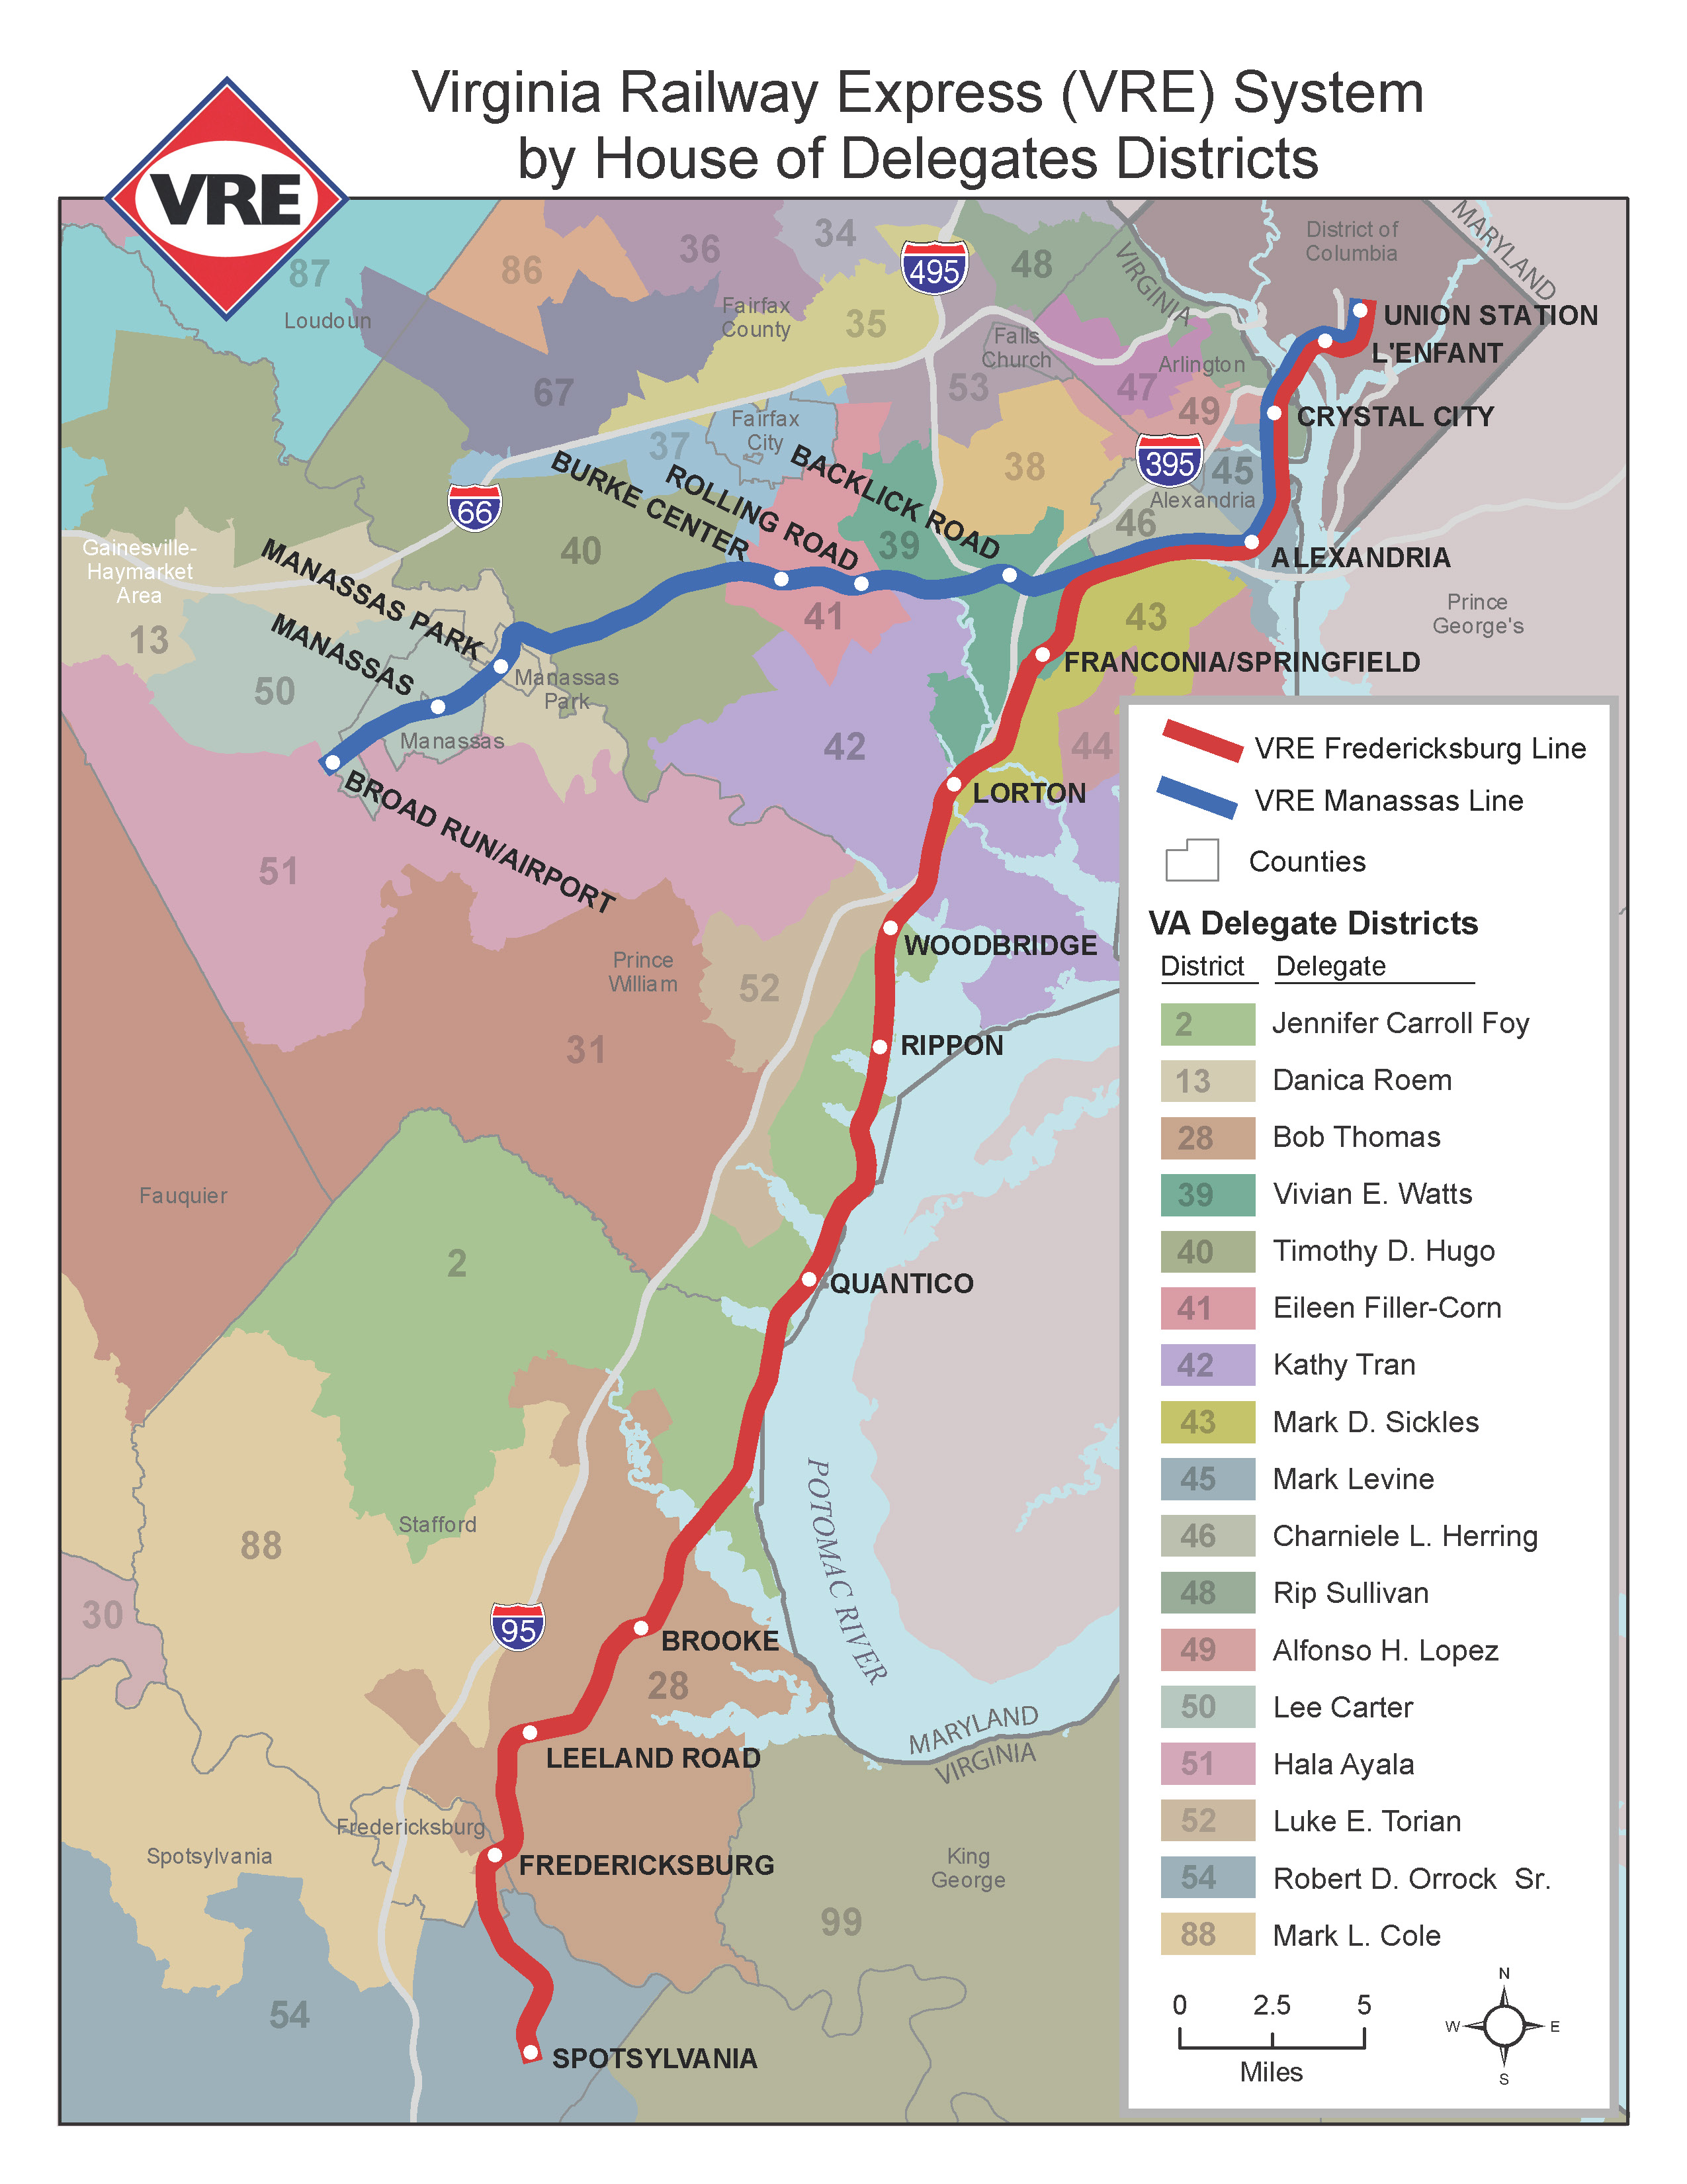
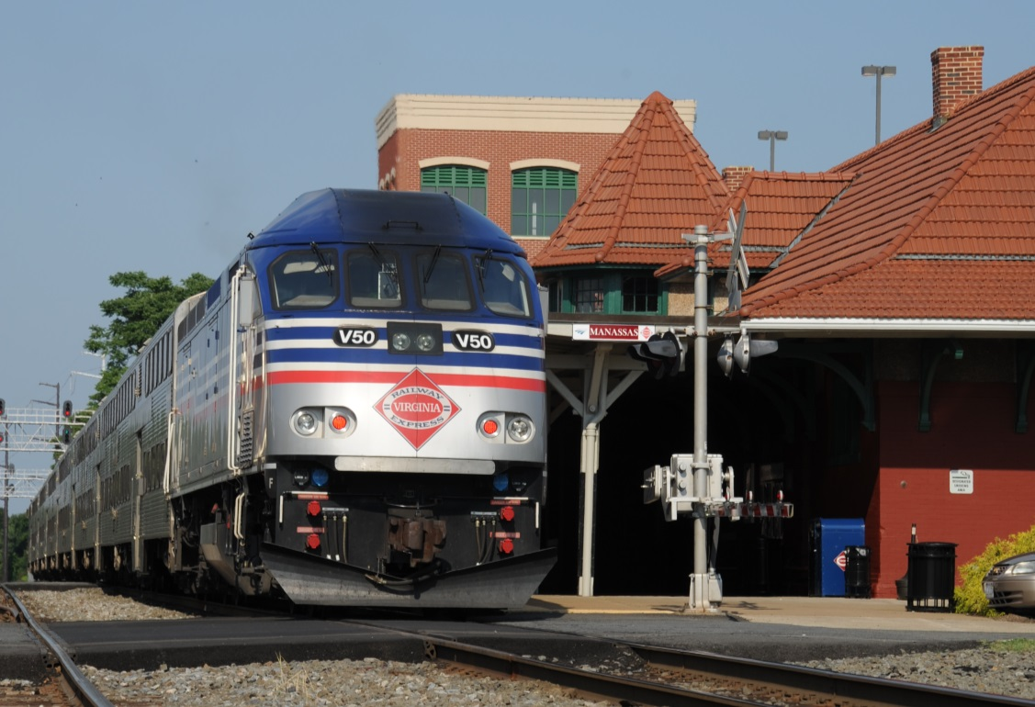
VRE TWO Lines
Manassas
I-66/I-395 corridor
36 miles/45 minutes to DC
16 weekday trains
10 stations (4 on both lines)
8,500 riders/day
Fredericksburg
I-95/I-395 corridor
60 miles/84 minutes to DC
16 weekday trains
13 stations (4 on both lines)
10,500 riders/day

Slide 4
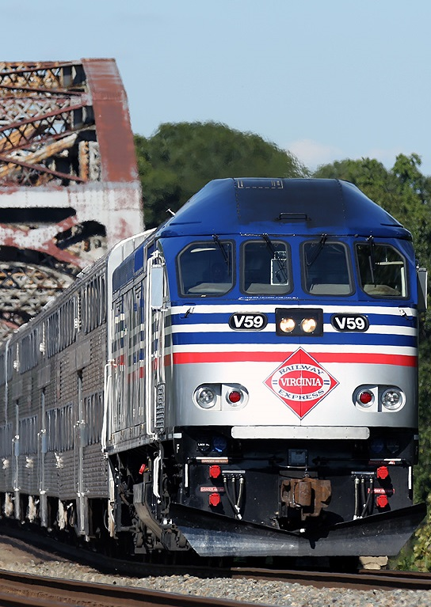
CORE Values
Safe Operations
High Customer Satisfaction
Quality Service
Reliable Service
Strong Partnerships with Host Railroads

Slide 5
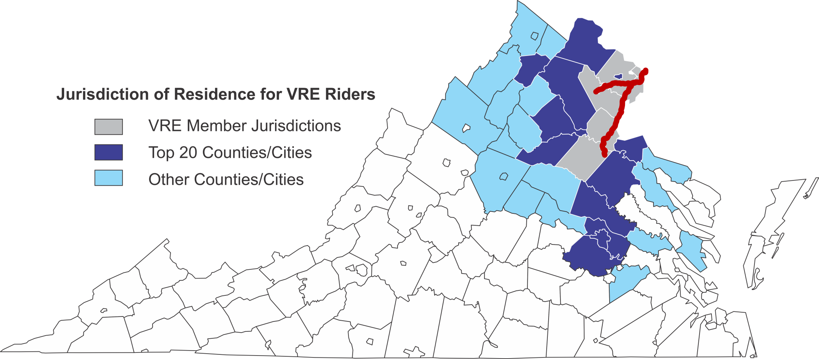
VRE Riders per Jurisdictional Residence
On a typical weekday, VRE draws ridership from 39 jurisdictions in Virginia.
Winchester
Washington DC
Manassas
Alexandria
*
Fredericksburg
Charlottesville
Richmond
* Source: 2015 Master Agreement Survey

Slide 6
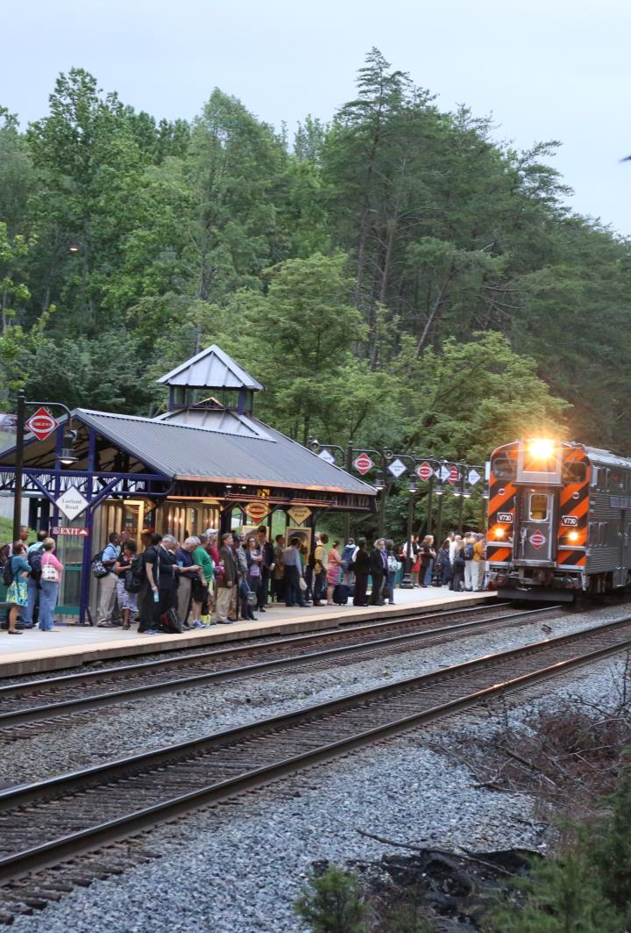
importance to northern Virginia
Part of a balanced transportation system
VRE equivalent to 150 more lane miles on I-95/I-395/I-66*
Contributes to traffic congestion reduction
VRE reduces peak delay up to 20% on I-95/I-395/I-66*
Doubling VRE ridership can reduce delay another 14%*
An effective means of adding peak transportation capacity
In 2017, NVTC reported that VRE & Metrorail boost state revenues by $600 million annually
* Source: Texas Transportation Institute, Virginia Railway Express Congestion Relief Contribution; 2014

Slide 7
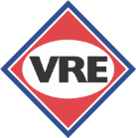
VRE SYSTEM PLAN 2040
Add rail capacity to grow to 50,000+ daily riders
PHASE 1:
Add railcars for longer trains
More station parking
More train storage
Second & longer platforms
PHASE 2 & 3:
Run more trains
Capacity improvements
Additional CSXT tracks
Long Bridge Expansion
More parking, railcars, yards
Phase I
Phase II

Slide 8
Commuter rail operating and capital (CROC) fund
New dedicated funding for VRE from gas tax floor in NVTC and PRTC regions
$15 million annually for operating or capital needs
Vital to VRE’s financial stability:
Offset operating expense growth without major increases in local subsidy or fares
Provide funding for critical capacity projects like L’Enfant Station and Fourth Track and Crystal City Station
Support future needs like railcar replacement
Phase I
Phase II

Slide 9
